Slide 1

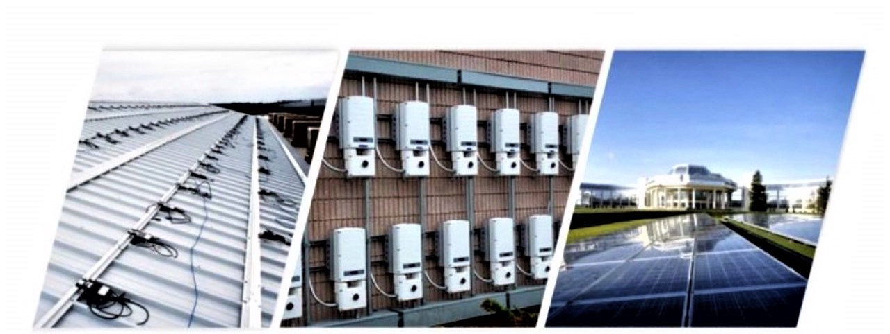

Project
Developed by A. Bonchev and Madlen Sekoulitchka

Slide 2




The Idea
This app, is aimed more towards the new hires -> help them be confident, and understand what they need to do, without making the customer suffer by being on the call longer than needed.
An application, that guides and helps the customer support representative. (Know more, Handle fast).
Integrated app, that has all the tools inside, the knowledge from InfoEdge, access to Credge that creates cases for you and generates your case notes.

Slide 3



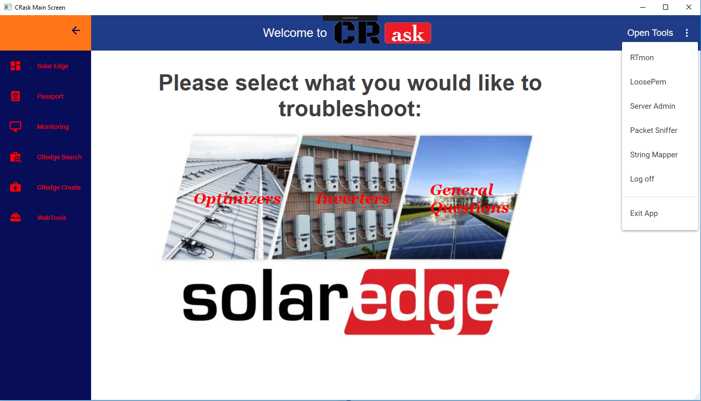

Preview

Slide 4





Main Features
Access to all the web-Based
tools
like: Passport, CRedge and etc.
Access to all local tools that you can start from the app: RTmon, LoosePem, Server Admin and etc.
General and simple guide for the customer support representative that is represented by small questions and as few as possible answers
Integrated videos in the application window (allowing you to also get the link if needed to the video, so you can send it

Slide 5
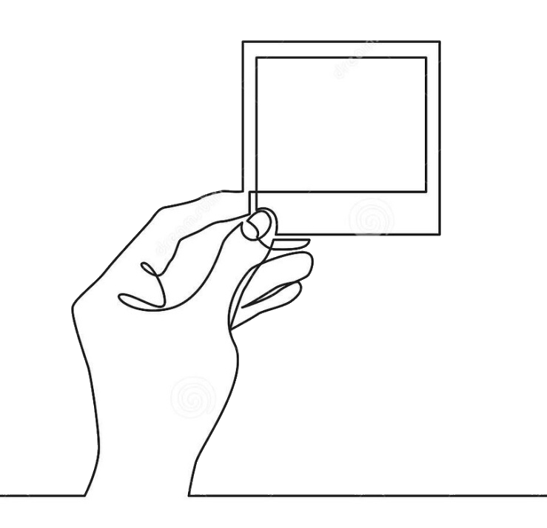
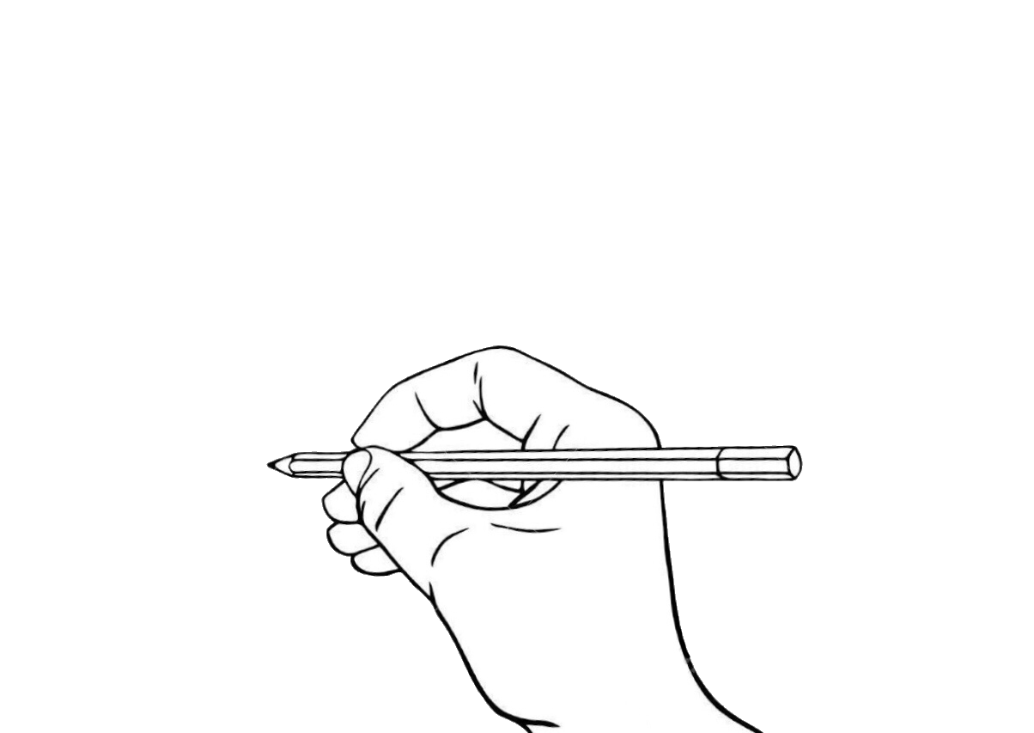
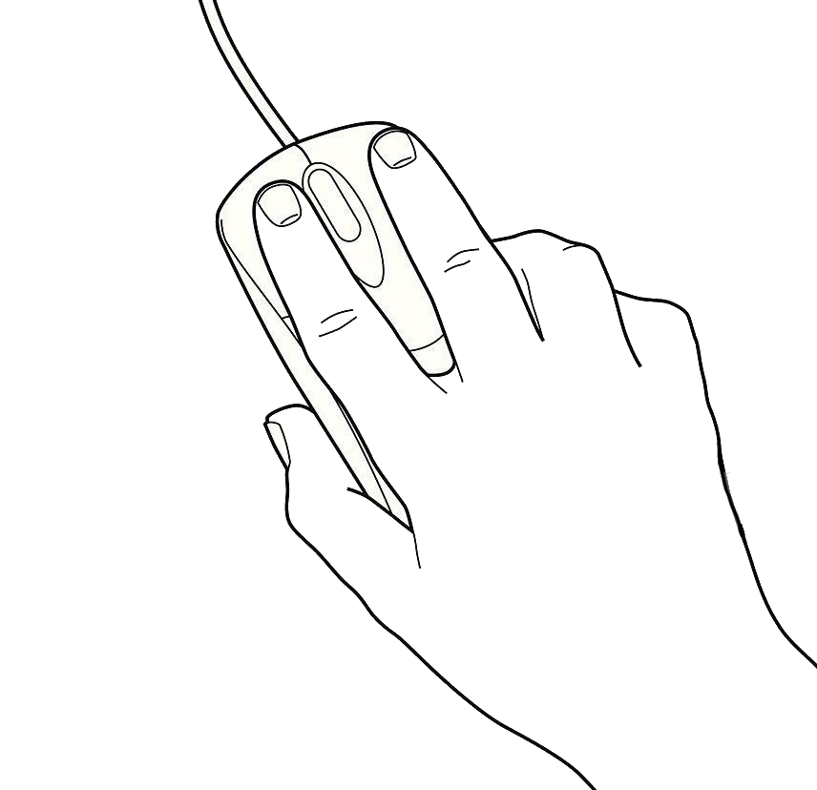
Main Features
Integrated picture gallery: a few photos for information regarding the current step, and the whole gallery with all the pictures inside (if you are just looking for pictures)
Auto-generated case notes that you can edit, copy and paste into your case, rather than spending time to write them in each call. (no more notes, that have almost no information in them)
Everything will work offline (without requiring you internet, so in case one of the sites goes down like infoedge, you can still get the information from the app)

Slide 6


Expandable Features
Send e-mails
Open cases
Add new contact information
Check site statuses
Integrated work with the rest of our systems, so we can directly open cases from our application, send emails through the application, check site statuses, add new contact information and so on.

Slide 7

Benefits of the project
Increase customer support efficiency. This will lead to lower handle time on a call by at least 20%. Less minutes on call -> less wait time -> one person can handle more calls (less people required) -> happier customers because they didn’t wait on the line and the call didn’t take long.
Less of a need to contact Tier 2. The income volume of calls to that tier will lower by at least 40% which will let them complete Tier 2 cases, create training materials and etc.
Less is more
more

Slide 8

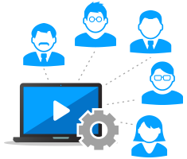
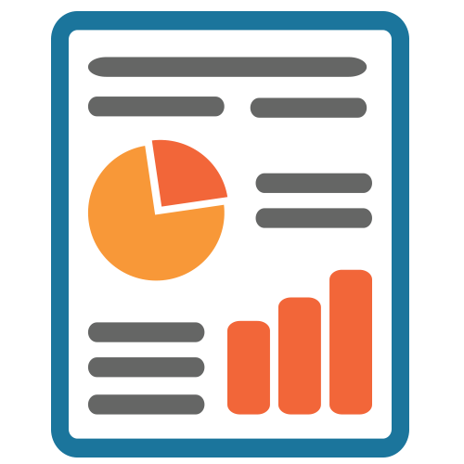
Benefits of the project
Less of a time with Tier 2 – The idea is that before calling them, you will get everything you need, so once you call them, there wont be a missed step done. Every outcome of the app will have a unique number, which you will be able to provide Tier 2, from where they will look it up an see instantly what you did, rather than taking a minute to explain. When enough escalations have been done, this can be implemented in to the app as a next step, from which it will prevent more calls for this, when a solid fix has been found.
Less of a hassle to find the required information for further troubleshoting. Infoedge has a lot of information, and this can be overwhelming at time. I have found myself several times, looking for the correct steps and articles, precious time, that can be avoided with this app.

Slide 9
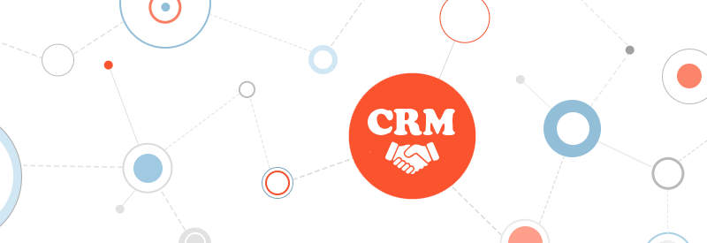
All in one
All in one – Trying to implement everything in one app, so we don’t have to load tools, open pages, search for information and so on. Everything can happen, just from the press of a few buttons in our application.

Slide 10

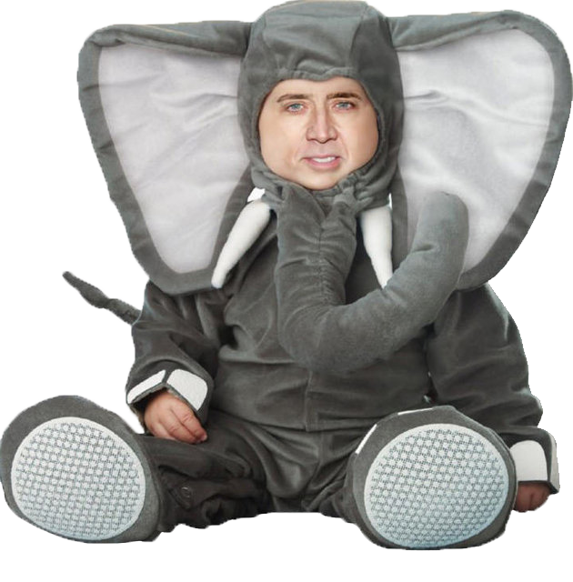
Any questions?

Slide 11
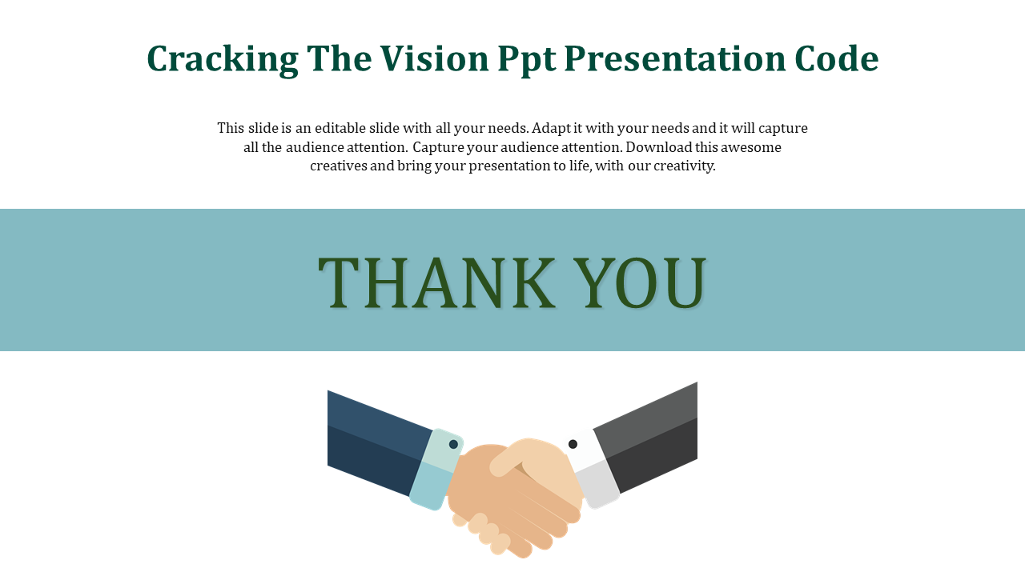
Thank you for the time!

